Slide 1
Our Institute
Activities, Facilities & Achievements
National skill training institute (women), Allahabad
6, New Katra, Prayagraj
Presented by: Khushi Maurya

Slide 2
About the Institute
National Skill Training Institute (women), Allahabad
Provides skill-oriented technical training.
Focuses on practical and industry- oriented learning.
Develops technical and professional skills among trainees.
Provides a supportive environment for skill development.
Encourages students to prepare for future career opportunities.

Slide 3


Trade Offered
AIPA- Artificial Intelligence & Programming Assistant
Programming Fundamentals
Artificial Intelligence
Computer Applications
Digital Technologies
Practical Skill Development
COPA- Computer Operator & Programming Assistant
• Computer Fundamentals
• Operating Systems
• Office Applications
• Internet & Web Basics
• Programming Fundamentals

Slide 4
Infrastructure & Facilities
Learning Facilities:-
Training Facilities:-
Classrooms
Spacious and well-organized classrooms for theoretical learning.
Computer Laboratories
Computer-based practical training and programming practice.
Learning Resources
Study materials and resources to support learning.
Computer Laboratories
Computer-based practical training and programming practice.
Learning Resources
Study materials and resources to support learning.
Practical Training
Hands-on activities for developing technical skills.
Digital Facilities
Use of computers and digital tools for training.
Training Environment
A structured environment for technical and skill development.
“A combination of theoretical learning and practical training supports overall skill development.”

Slide 5


Training Activities
Classroom Training
Practical Training
Theory and concrptual learning
Instructor-led session.
Technical discussions
Presentations and demonstrations
Hands-on computer practice
Programming exercises
Practical assignments
Project-based learning
Problem-solving activities

Slide 6
Student & Training Activities
Learning
Project
Assessment
Skill Development
Practical

Slide 7
Achievements & Performance

Slide 8
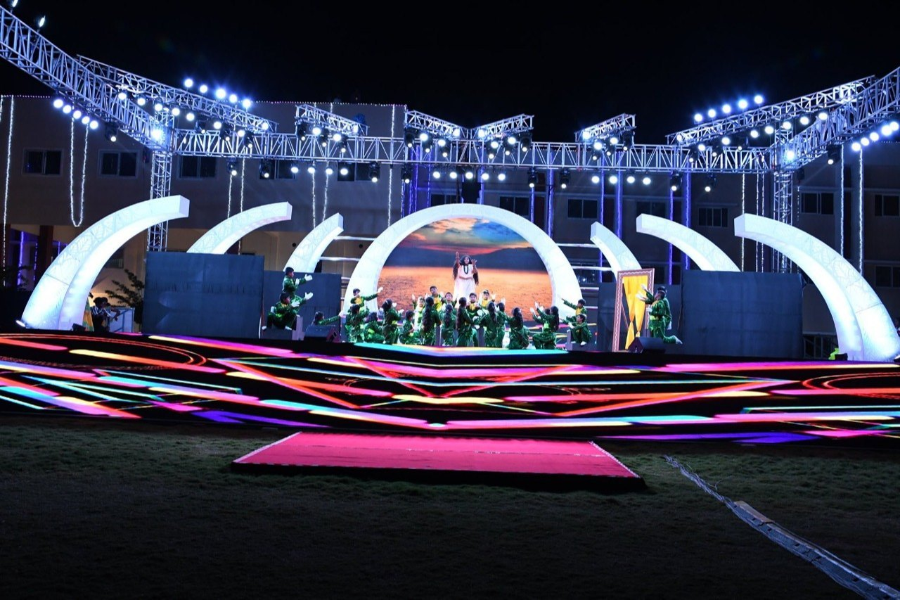
Events & Celebratioons
National and institutional celebrations
Skill development activities
Awareness programs
Student participation activities
Educational and cultural events

Slide 9

Role of Technology & AI in Training
Technology & AI:
Digital learning
Computer-based practice
Online learning resources
Multimedia presentations
Software applications
AI concepts
Intelligent applications
Automation
Problem-solving
Future-ready skills

Slide 10
Future Plans & Skills
Practice
Learn
Grow
Innovate
Advanced technical skill development
Greater use of AI and digital technologies
Practical and project-based learning
Industry-oriented training
Career and employment opportunities
Continuous learning and upskilling

Slide 11


